Slide 1
Industrial AI Research Centre
Driving innovation for industry through AI
https://www.unisa.edu.au/research/industrial-ai/
A/Prof Wolfgang Mayer, Wolfgang.Mayer@unisa.edu.au

Slide 2
Centre Overview
110+ members
35+ Academics & project staff
Computer Science
Mathematics/Statistics
Engineering
64 PhD Students
Various levels of security clearance
$3.9 Million Research Income (in 2022)
unisa.edu.au/research/industrial-ai/

Slide 3
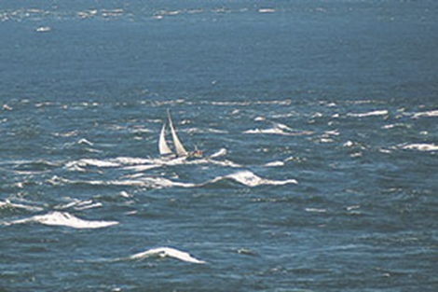
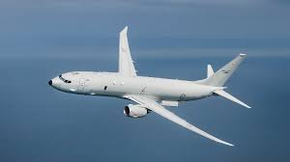
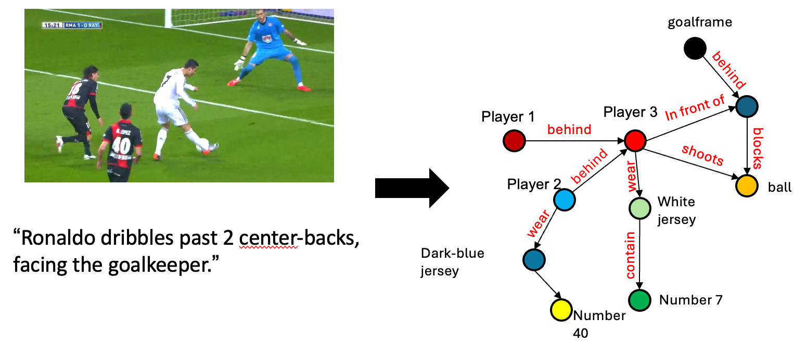
Sensor Placement and Data Fusion
Remote Sensing, UxV
Signal Processing
Optimal Sensor Placement
Target Localisation
Dynamic Path Planning & Target Selection for ISAR Imaging
Multi-Modal Data Fusion
Goal-Directed Information Acquisition, Fusion, and Monitoring

Slide 4
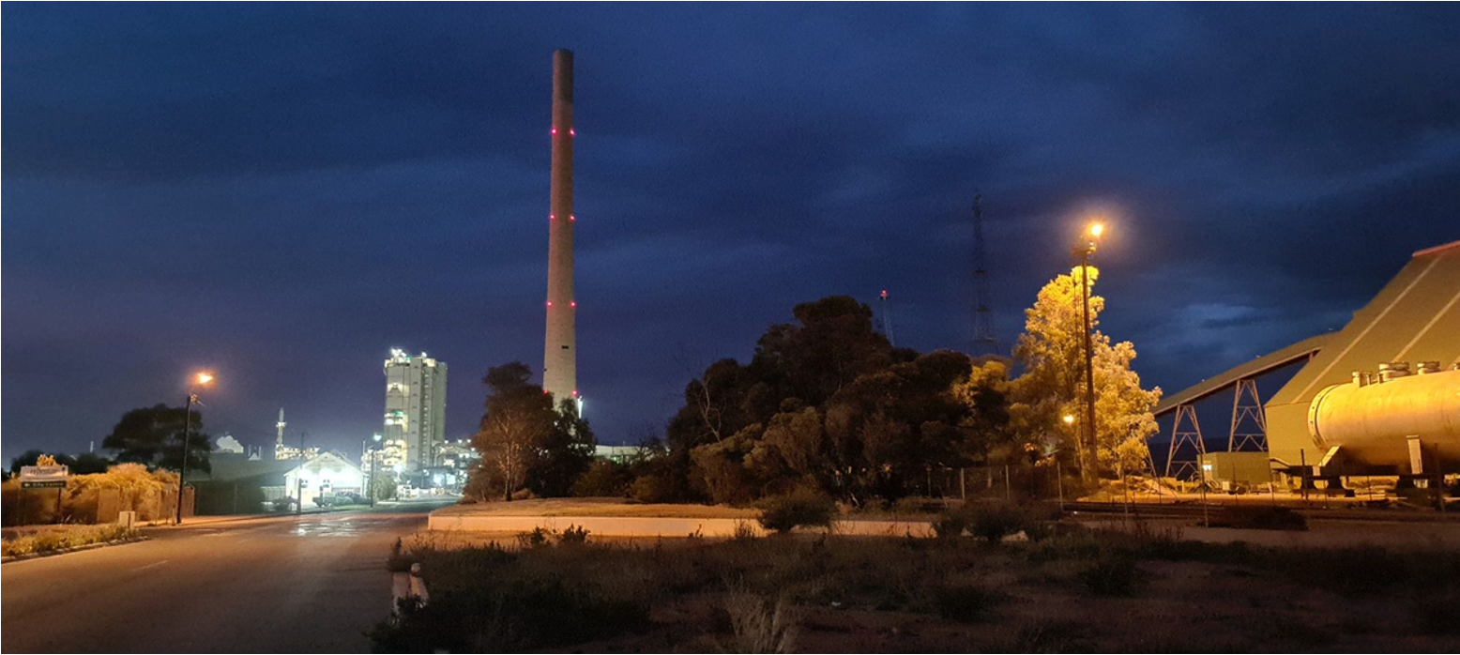
Dispersion Modelling Pattern Recognition
Modelling of lead (re-)deposition
Environmental influences
Limited sensing ability

Slide 5
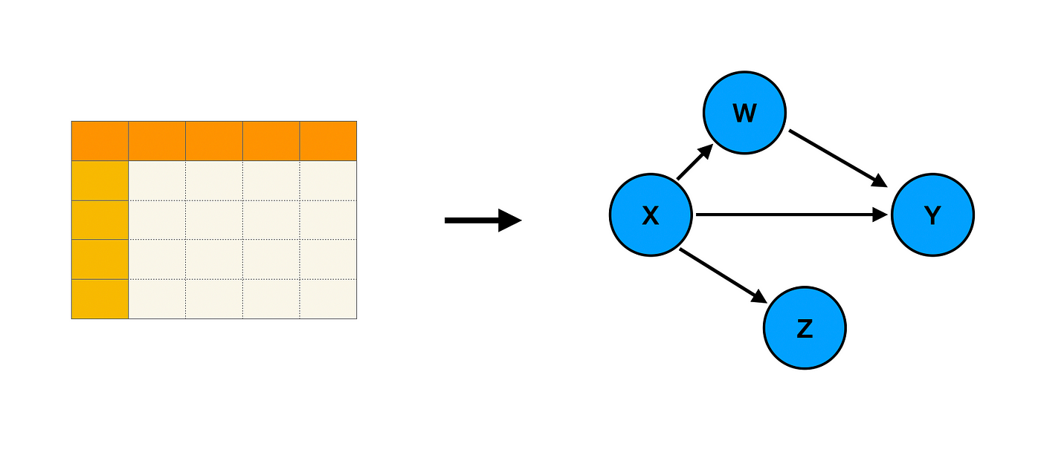
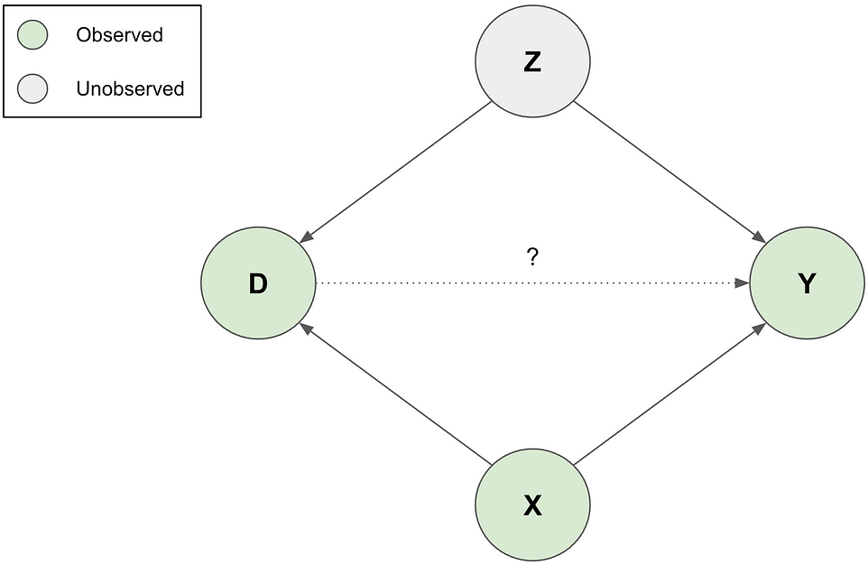
Causal Discovery, Inference, Explanation Anomaly Detection
Causal learning from observational data & time series
Causal effect estimation
Causally Robust ML
Bias Correction
Anomaly Detection
Notes:
Image from: https://towardsdatascience.com/sensitivity-analysis-for-unobserved-confounding-465970a969e0

Slide 6
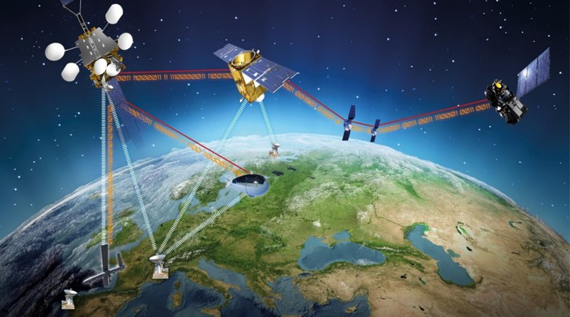
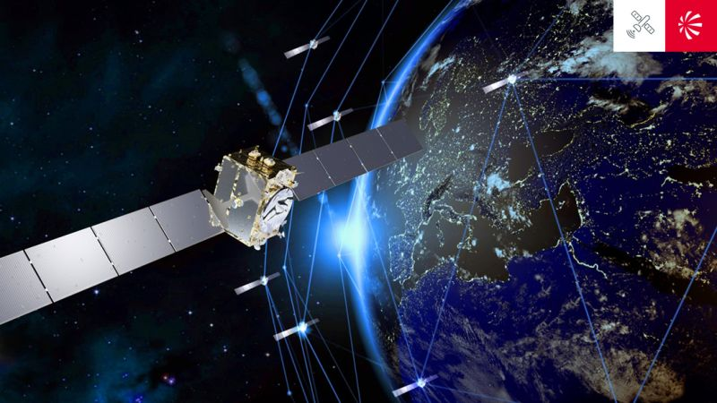
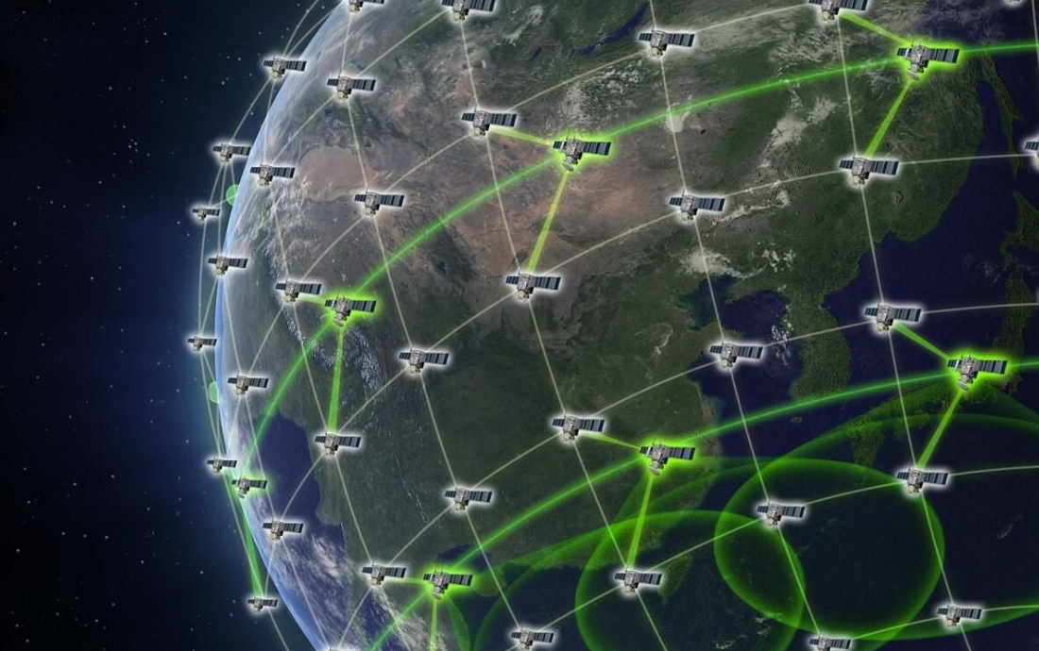
Machine Learning: distributed, continual, cross-domain
Onboard ML, analysis, planning
Goal-oriented autonomy
Systems-of-systems autonomy
Small spacecraft & constellation resilience

Slide 7
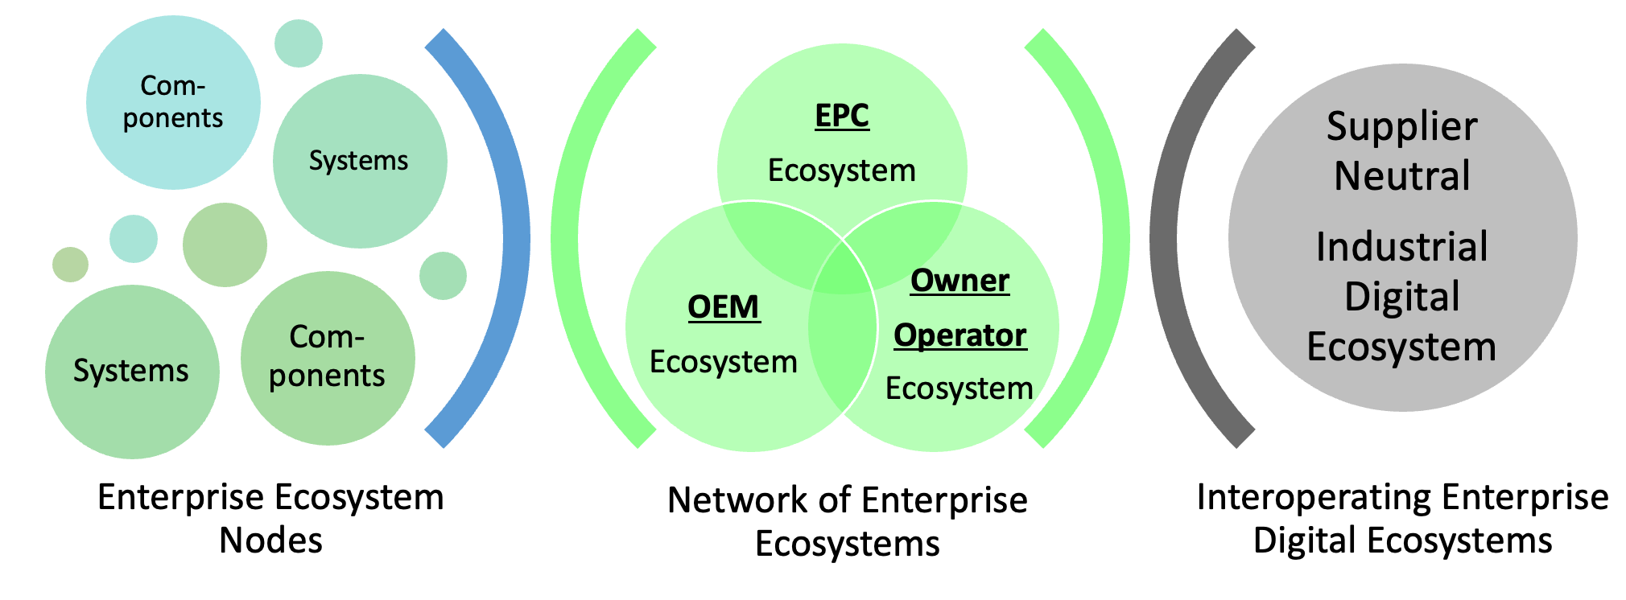
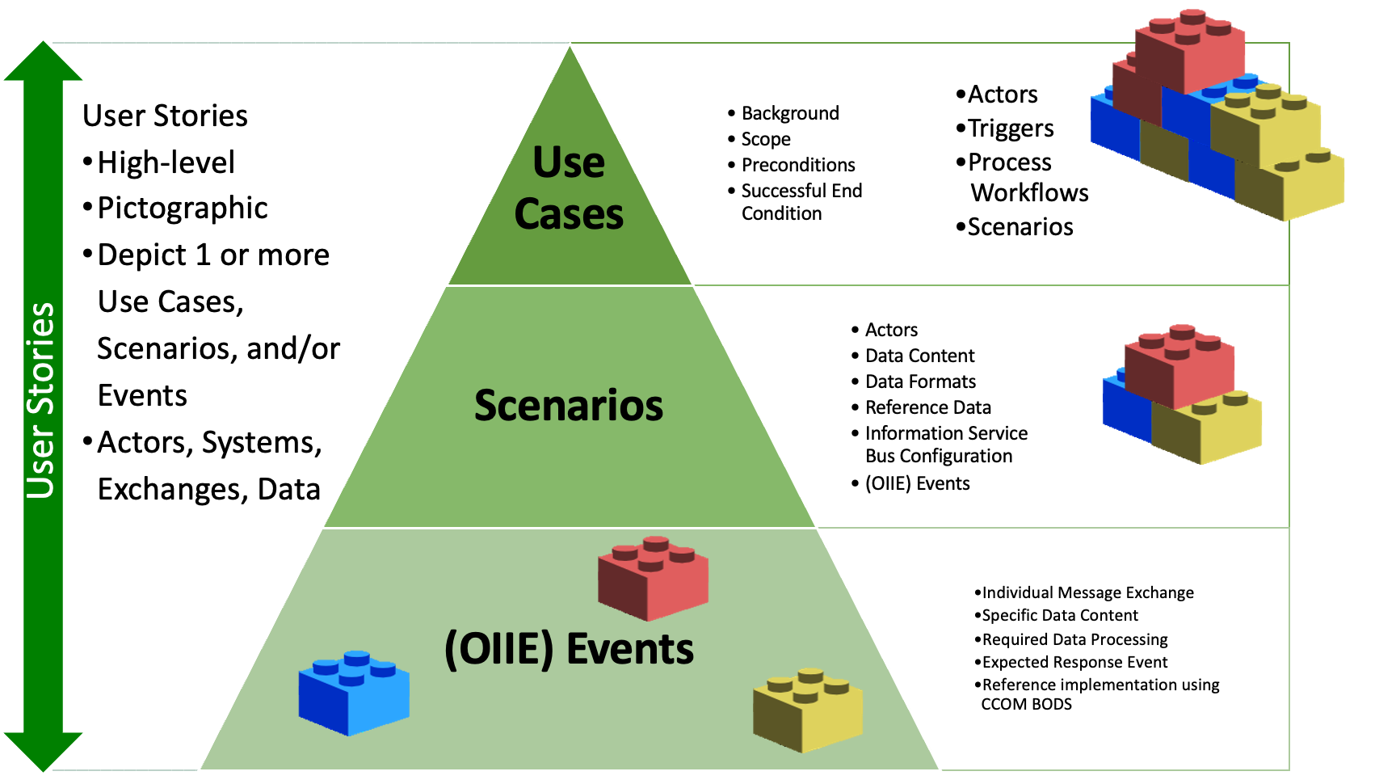
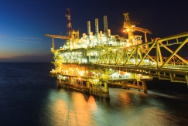
Information Architecture and Interoperability
Interoperable information and analytics ecosystems
Data integration architectures
Architectures for evolving systems
Data standards & ontologies

